Slide 1
Parsehub -Web scraping Assignment
Abdullah Amin chotani - 18658

Slide 2
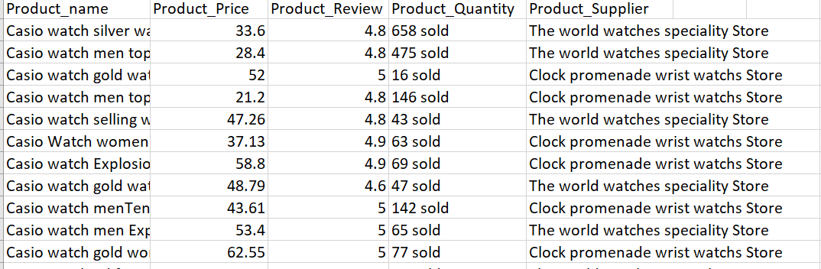
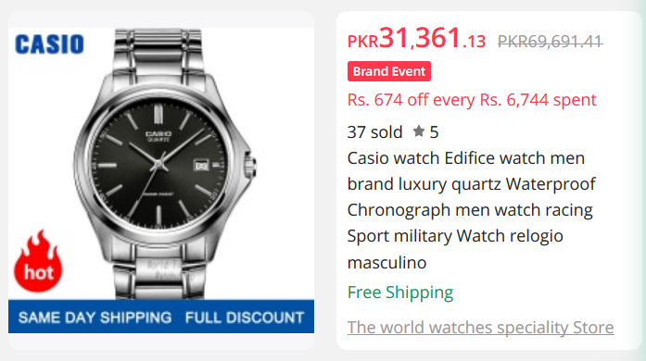
Scraped data
Scraped data consists of product details from Alibaba. Our data consists of 150+ rows and 5 columns.
Product_name : Name of the product
Product_Price : Price of the product in USD
Product_Review: Rating of the product based on reviews
Product_Quantity: Quantity SOLD of the product
Product_Supplier: Supplier name of the product

Slide 3
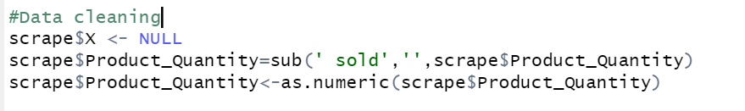
Data cleaning
First we removed a blank column. Then we cleaned the data by removing the “sold” after each quantity. We then changed the quantity in to numeric values.

Slide 4
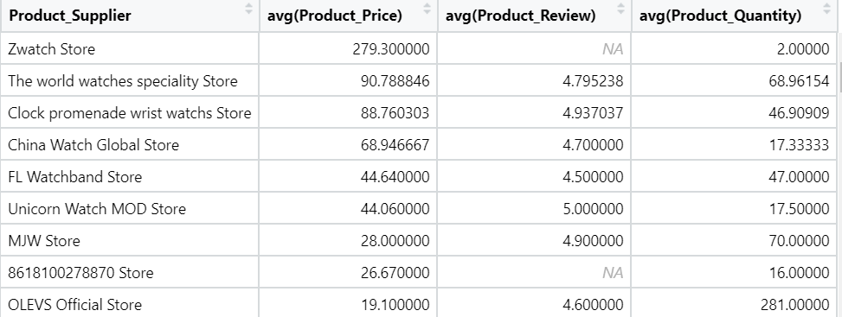
Data Analysis
We wrote an SQL query to take out the average product reviews, prices and quantities and grouped them by suppliers ordering them with the highest price.
Zwatch store has the most expensive items on average.

Slide 5
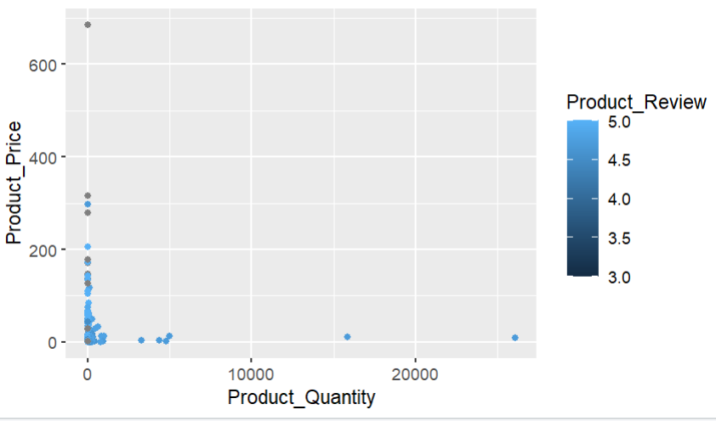
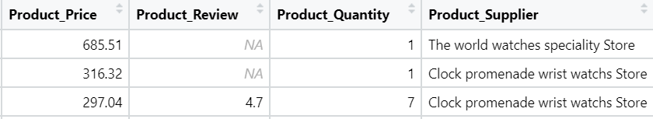
Outlier Analysis
We then checked the correlation and distribution of the overall data. Turns out, there are 3 outliers within the data with greater than 10000 quantity sold and one with a product price greater than 600. This product has a review of around 3 which is not good. It seems to have only one quantity sold. It seems that the product with the least prices have the most quantity sold. Suppliers can look to list products under $10 for increased sales.

Slide 6
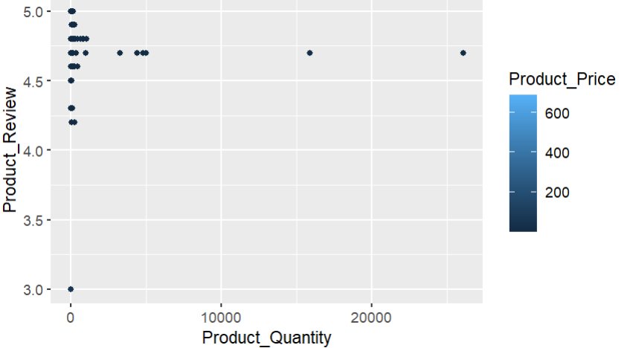
Do supplier reviews really make a difference?
Moving on, we see that there is no direct correlation between the reviews a product has and the quantity sold of the product. Products with average reviews have sold a lot of quantity.

Slide 7
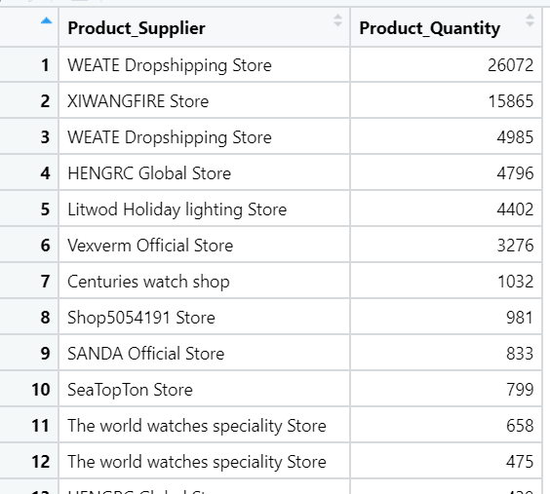
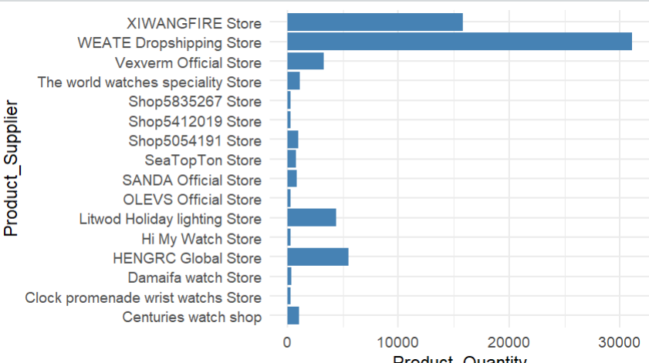
Suppliers who sold the highest quantity
We wrote an SQL query to view the top suppliers who sold the highest quantity and visualized the data on a bar graph.

Slide 8
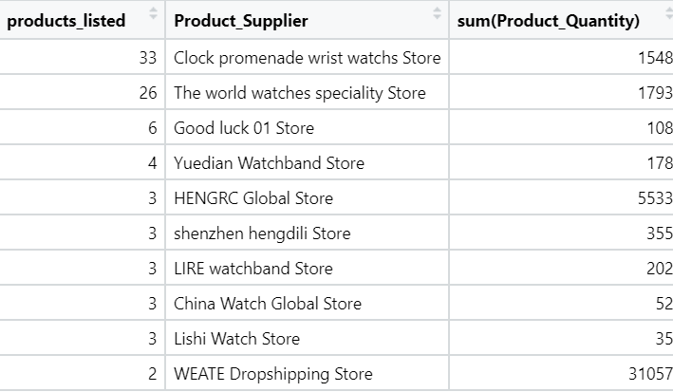
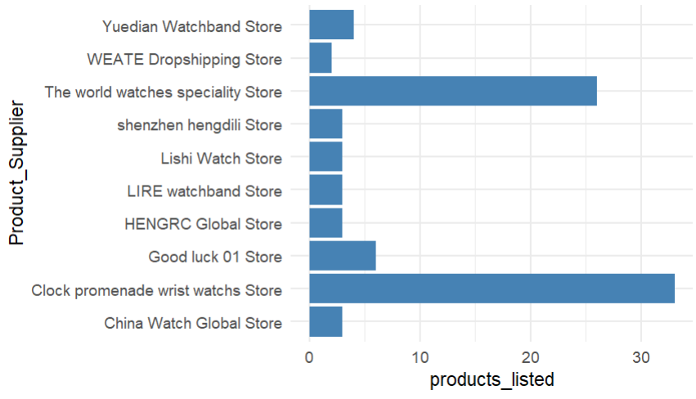
Suppliers who have the most listed items and quantity sold
Clock promenade wrist watch store and world watches have the highest products listed. WEATE drop shipping has only two products listed with the most quantity sold. Suppliers can look to start with listing 1-2 products and achieving economies of sales.

Slide 9
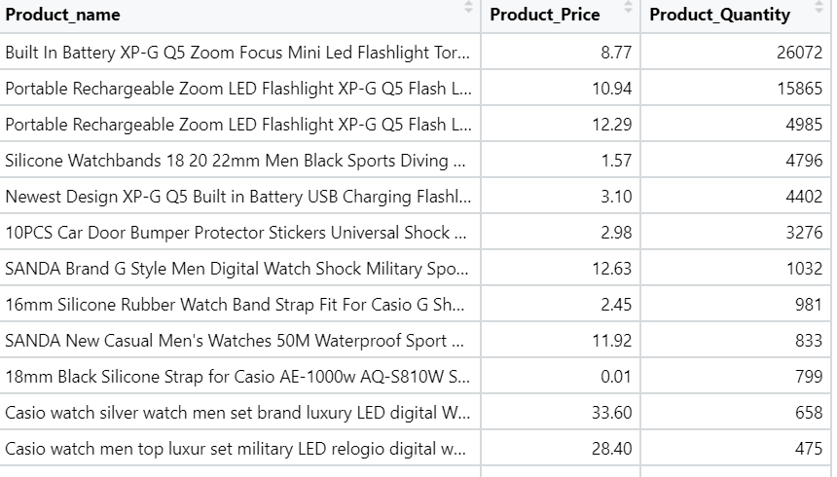
Highest selling product

